Slide 1
Chapter 18: ANOVA
Textbook: Ahmad Daryanto, Introduction to Quantitative Research Methods for Marketing With SPSS and R: Tools and Techniques, Routledge. 2024

Slide 2
Learning Objectives
Able to analyse data using one-way ANOVA
Produce and interpret SPSS and R outputs on ANOVA

Slide 3
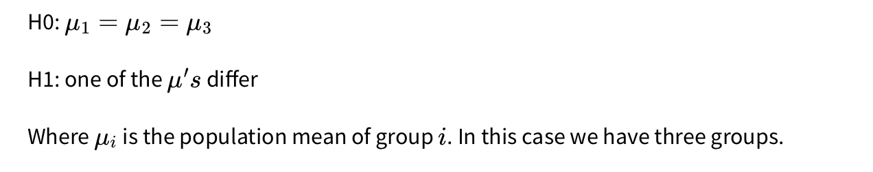
Why ANOVA?
To compare means of more than two groups.
The null and alternative hypotheses are

Slide 4
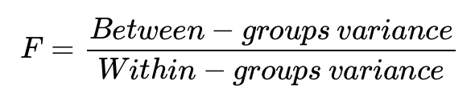
Testing the null hypothesis in ANOVA is based on an F statistic calculated as:
The calculation of between-groups variance is based on the variance of the sample means, whereas the calculation of within-groups variance is based on the variance of scores within each group.
When the null hypothesis true, the F statistic has a sampling distribution
that is distributed according to an F distribution.

Slide 5
Assumptions
Observations within each group should be independent.
Normality: The population distribution within each group should follow a normal distribution. If population distribution is not normal, if a sample size is larger than 30, by the central limit theorem, the distribution of the sample means approaches a normal distribution. If the sample means are normally distributed, the F statistic will have an F sampling distribution.
Equal variances: The variances of the observations within each group should be equal. This means that the spread of the responses should be similar across groups. This assumption may not be held in practice. When group sample sizes are not equal and one group has a standard deviation that is more than twice the smallest group standard deviation, the ANOVA results will be misleading (Agresti, 2018)

Slide 6
Illustration
Are the mean differences across the age groups?
Young vs. middle-aged vs. elderly in their intentions to repurchase a product that is currently unavailable in his store shelf.
Item measuring their repurchase intention: “I want to repurchase product A if it is available again in this store” (1 = strongly agree to 7 = strongly agree).
Data: repurchase.sav

Slide 7
SPSS syntax
Data: repurchase.sav
ONEWAY repurchase BY age
/ES=OVERALL
/STATISTICS DESCRIPTIVES HOMOGENEITY
/PLOT MEANS
/MISSING ANALYSIS
/CRITERIA=CILEVEL(0.95)
/POSTHOC=TUKEY GH ALPHA(0.05).

Slide 8
Descriptive statistics and means plot

Slide 9
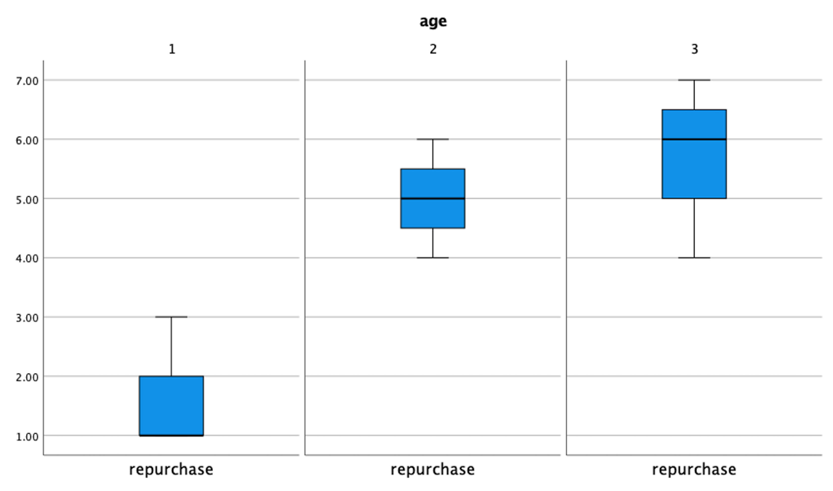
Multiple Boxplots

Slide 10
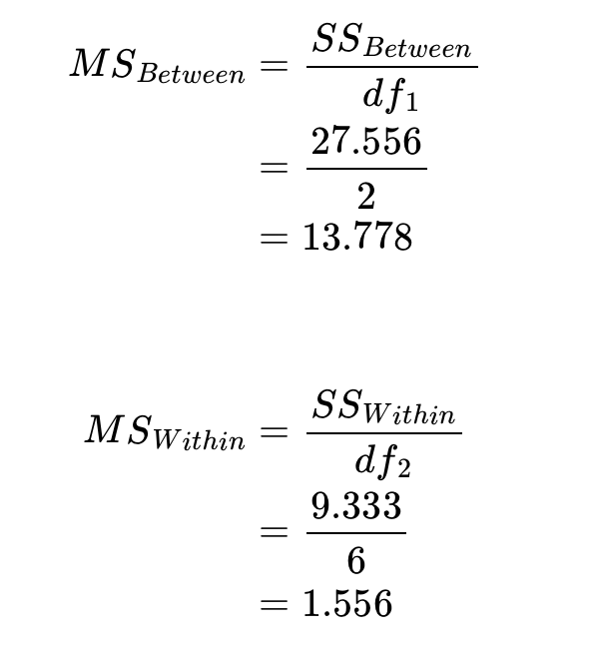
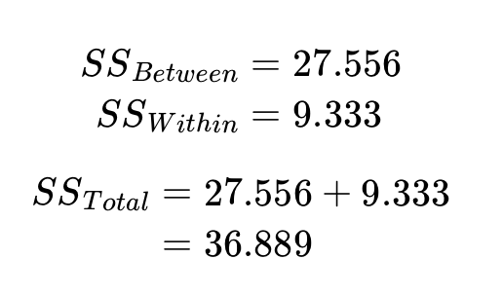
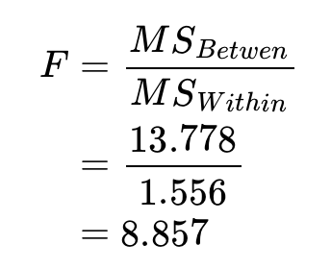

Slide 11
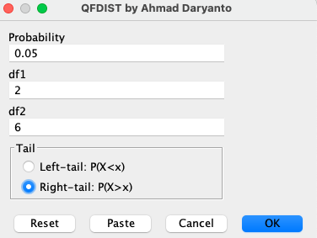
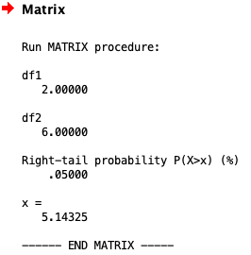

Slide 12
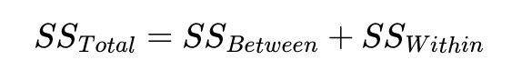
Sum of squares
Dividing between-groups of sum of squares by its associated degrees of freedom (K−1) results in a between-groups variance, which quantifies the variance among scores that is due to group differences. Dividing within-groups of sum of squares by its associated degrees of freedom (N−K)results in a within-groups variance, which represents the variance that is due to differences among scores within groups.
Between-groups sum of squares is calculated as the sum of the squared differences between each group mean and the grand mean
Within-groups sum of squares is calculated as the sum of the squared differences between each observation and the group mean, calculated for each group, and added all together

Slide 13
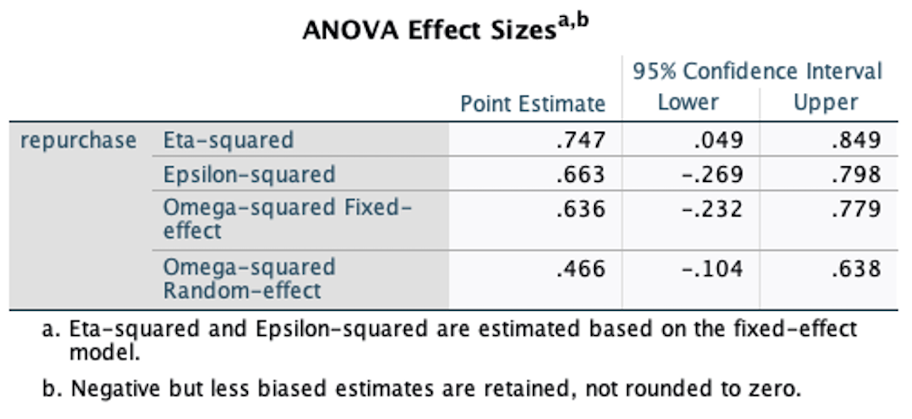
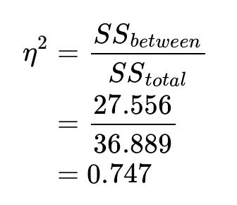
Effect Size
eta-squared (η2) represents the proportion of the total variance in repurchase that is accounted for by age

Slide 14
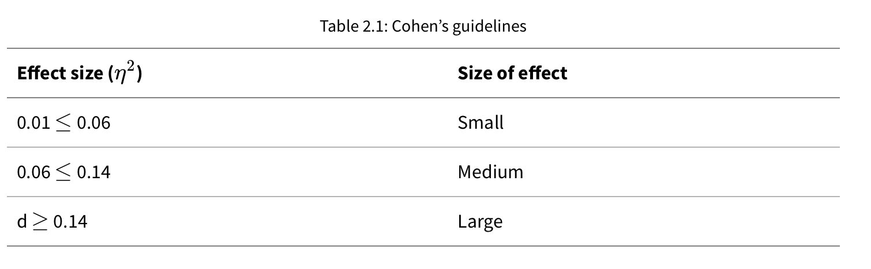

Slide 15
Finding Out Which Groups Differ
The aim to locate the location of the difference is the F test is significant.
There are many post hoc tests available – 18 tests in the One-Way ANOVA procedure in SPSS. The choice of which test that we can use is guided by the results of the homogeneity of variance test or Levene’s test.
The null hypothesis in the homogeneity of variance test is that the variance of scores across groups are the same.

Slide 17
There is no significant difference between the means of these two groups. Each mean is significantly different from the mean of group 1

Slide 18
R code
library(haven)
library(tidyverse)
library("ggpubr")
#| out.height: "40%"
#| out.width: "40%"
#| fig.align: "center"
# load data
dat <- read_sav("/Users/ahmaddaryanto/Documents/Data1/repurchase.sav")
# convert "age" as a categorical variable.
dat <- dat |>
mutate(age = as_factor(age))
# group the data by the factor "age"
dat <- dat |>
group_by(age)

Slide 19
# calculate the number of observations,
# mean, standard deviation and for each group
desc_stats <- dat |>
summarize(n = n(),
mean = mean(repurchase),
sd = sd(repurchase))
# print the descriptive statistics
desc_stats
# produce box plots
ggboxplot(dat, x = "age", y = "repurchase",
xlab="Age Group",
ylab="Repurchase Intention") +
theme_grey()
# perform ANOVA
fit <- aov(repurchase ~ age, data = dat)
# print summary
summary(fit)

Slide 20
Two-Way ANOVA
Involving two variables.
For example, the effect of Age and Gender on Repurchase Intention
UNIANOVA repurchase BY age male
/METHOD=SSTYPE(3)
/INTERCEPT=INCLUDE
/PLOT=PROFILE(age*male) TYPE=LINE ERRORBAR=NO MEANREFERENCE=NO YAXIS=AUTO
/PRINT ETASQ DESCRIPTIVE
/CRITERIA=ALPHA(.05)
/DESIGN=age male age*male.

Slide 21
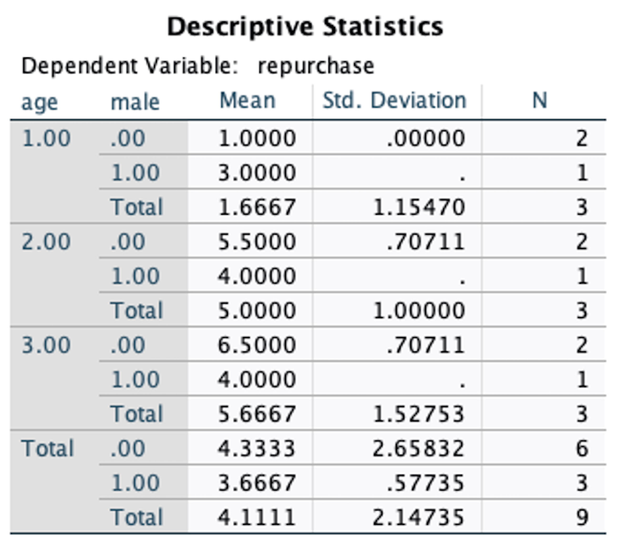
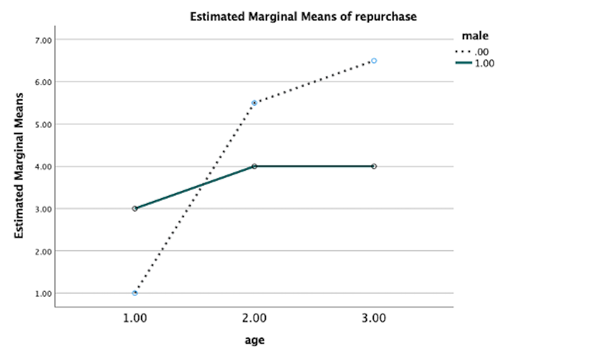
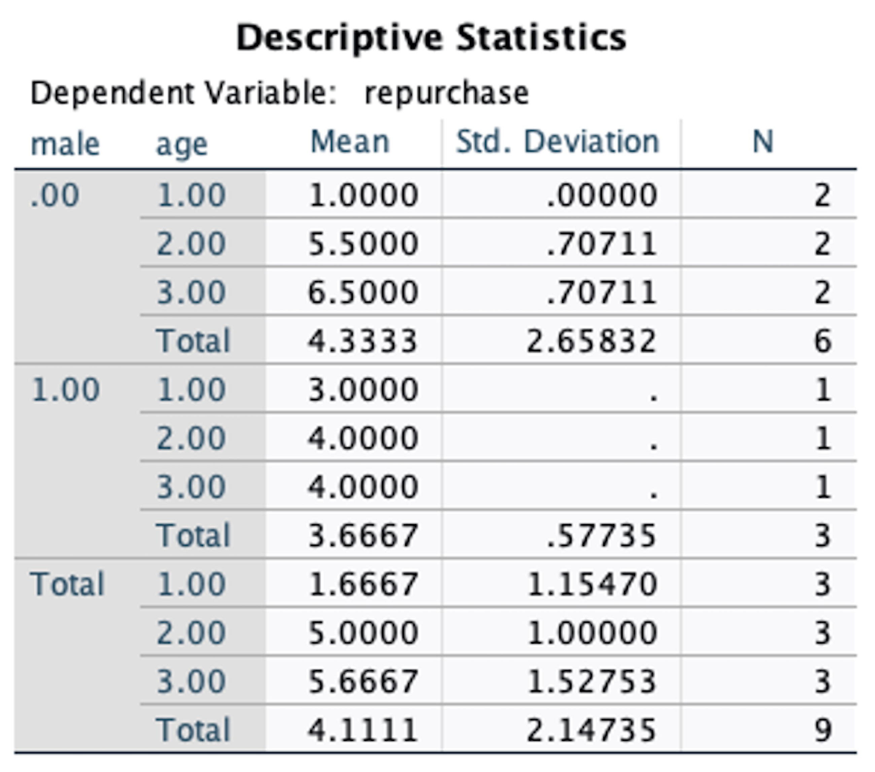

Slide 22
R Action
library(tidyverse)
library(haven)
library(car) # to run leveneTest() function
# load the data
dat <- read_sav("/Users/ahmaddaryanto/Documents/Data1/repurchase.sav")
# convert "age" as a categorical variable.
dat <- dat |>
mutate(age = as_factor(age))
# perform a two-way ANOVA
# age:male is the same as age*male
# age:male is an interaction term
fit <- aov(repurchase ~ age + male + age:male , data = dat)
# print summary
summary(fit)

